Slide 1

Updates on prompt atmospheric muon analysis Ludwig Neste and Pascal Gutjahr
CR-Call September 29, 2023
Source: NASA

Slide 2

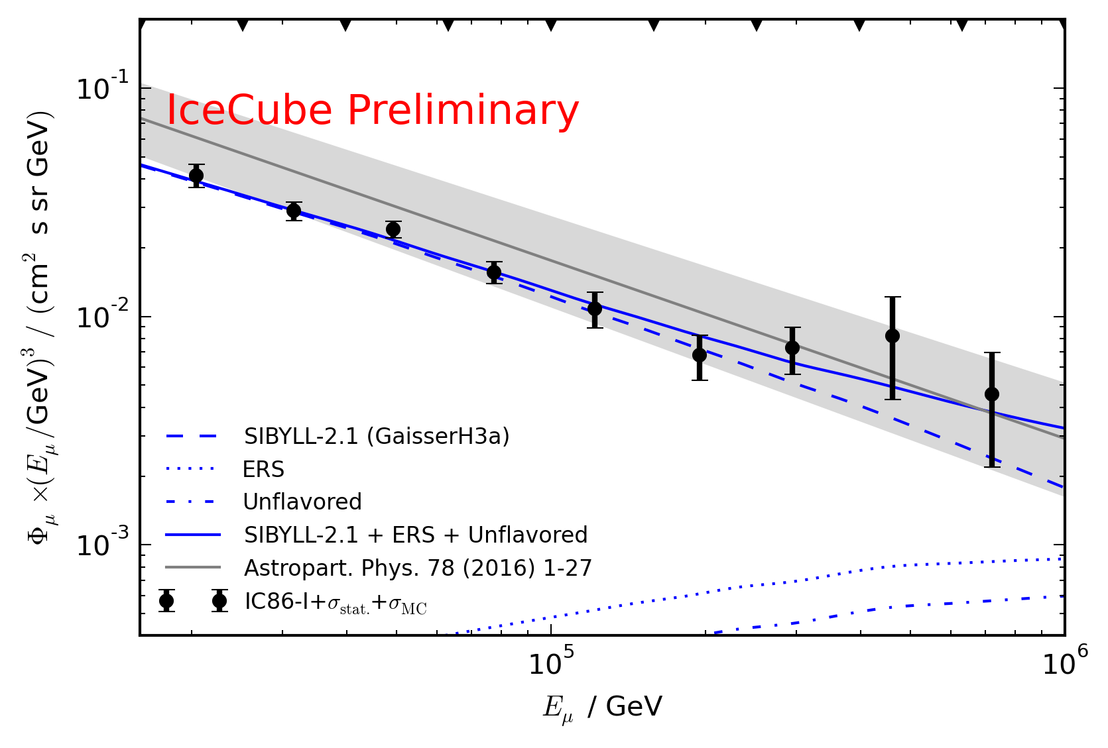
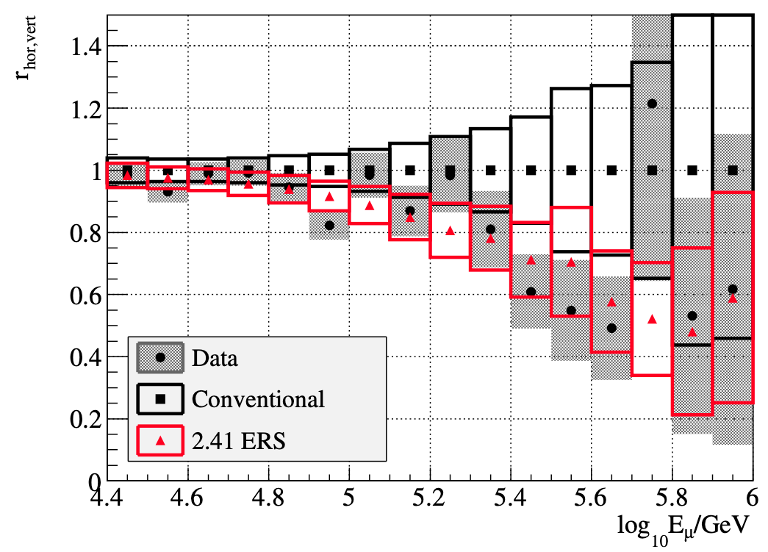
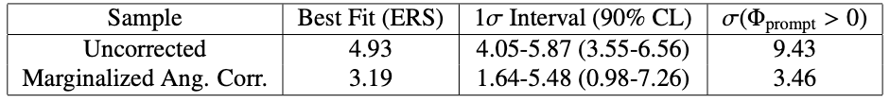
Motivation
Prompt atmospheric muons have never been significantly measured
Old analyses:
Leading muon analysis: limited MC statistics (by Tomasz Fuchs, https://wiki.icecube.wisc.edu/index.php/Analysis_of_Leading_Muons)
Characterization of the muon flux: zenith problem (by Patrick Berghaus, https://arxiv.org/abs/1506.07981)
Good analyses with some issues

Slide 3
Intention
Detect prompt component of the atmospheric muon flux significantly
Measure the normalization
Get handle on hadronic interaction models
Unfold an energy spectrum
Idea:
New CORSIKA simulations with extended history
Tag muons by parent → prompt or conventional
Scale amount of prompt particles
Scaling saves time and resources instead of doing multiple simulations with different interaction models
Perform forward fit of the prompt normalization

Slide 4
Some definitions and wording…
Leading muon
The most energetic muon inside a bundle (no minimum fraction required)
Single muon
Except for stopping and very low energetic muons, there are never any single muons (almost every event is muon bundle)
Prompt muon
Muon parent is pion or kaon
Suggestion:
To avoid confusion regarding different leading muon definitions we can introduce a “leadingness” (For example: Tomasz used a leadingness of 50%, …)
Most energetic muon inside
Muon parent:
pion or kaon
no
yes
conventional
prompt

Slide 5
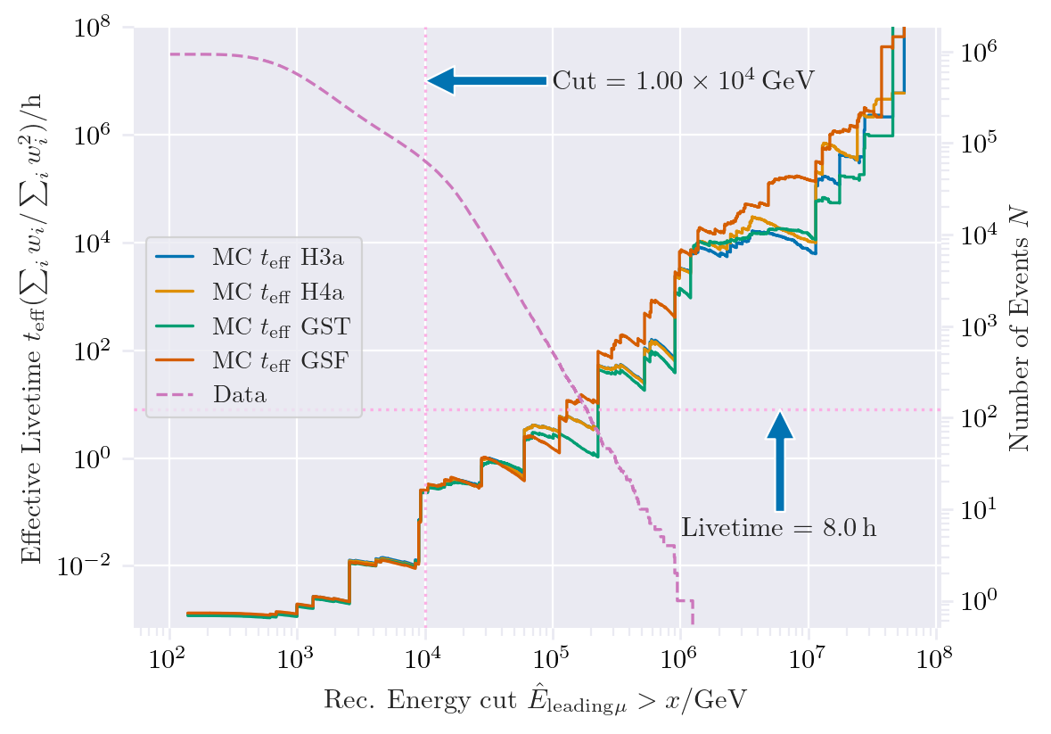
New CORSIKA extended history simulations
CORSIKA 77420
SIBYLL 2.3d
Icetray 1.5.1
5 components (p, He, N, Al, Fe)
Polyplopia: True
Trimshower: True
Ecuts1: 273 GeV (hadron min energy)
Ecuts2: 273 GeV (muon min energy)
Ecuts3: 10²⁰ GeV (electron min energy)
Ecuts4: 10²⁰ GeV (photon min energy)
4 datasets:
30010: 600 GeV – 1 PeV
30011: 1 PeV – 100 PeV
30012: 100 PeV – 1 EeV
30013: 1 EeV – 50 EeV
/data/sim/IceCube/2023/generated/CORSIKA_EHISTORY/
Please go ahead and test the datasets
Sufficient statistics above 1 PeV
Too few statistics at lower energies

Slide 6
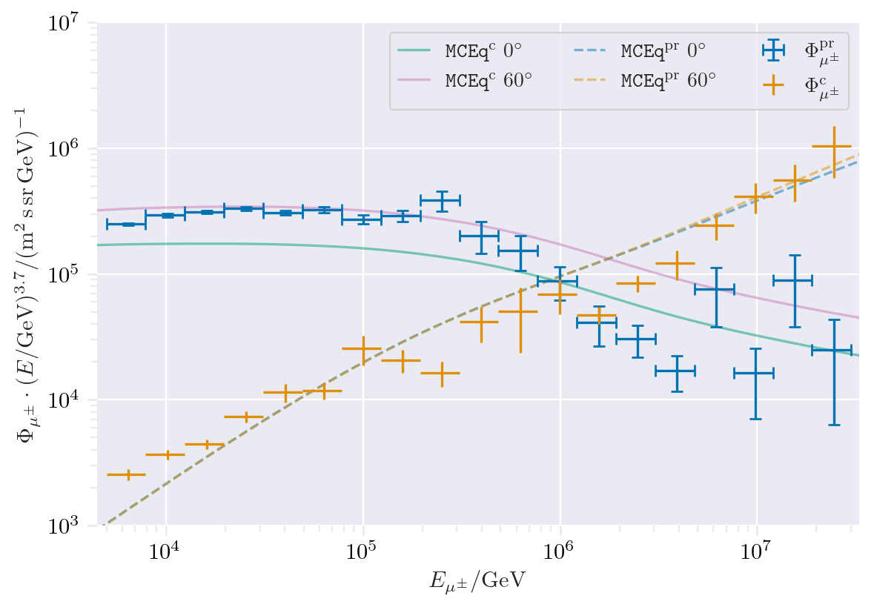
CORSIKA vs. MCEq
Most energetic muon inside
Muon parent:
pion or kaon
no
yes
Good agreement
conventional
prompt
CORSIKA standalone
IceCube CORSIKA step 0
For detailed information, see the talk by Ludwig Neste at the upcoming collaboration meeting

Slide 7
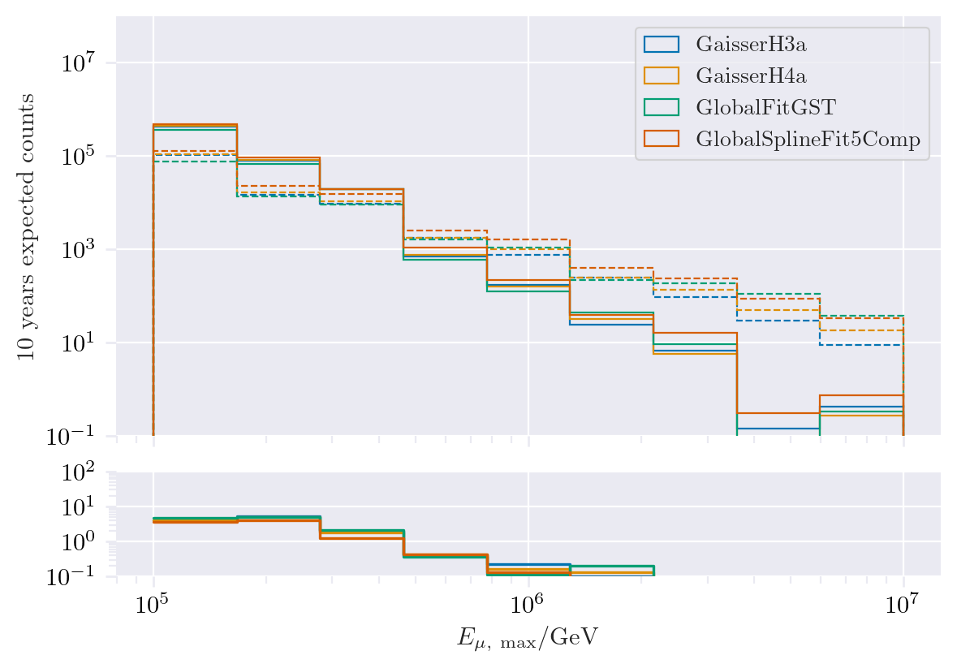
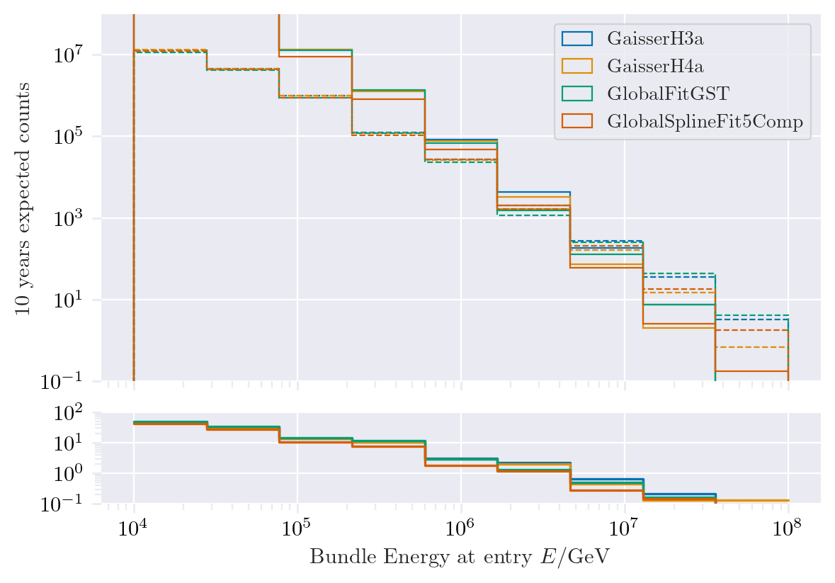
Expected muons for 10 years: leading vs. bundle energy
Solid: conventional
Dashed: prompt
Different primary fluxes lead to different prompt fluxes
Bundle energy extends to higher energies

Slide 8
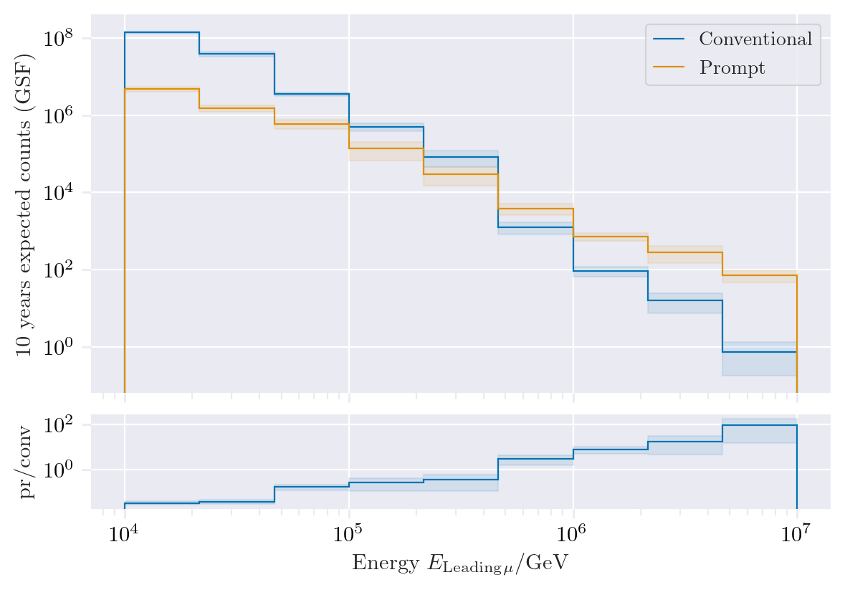
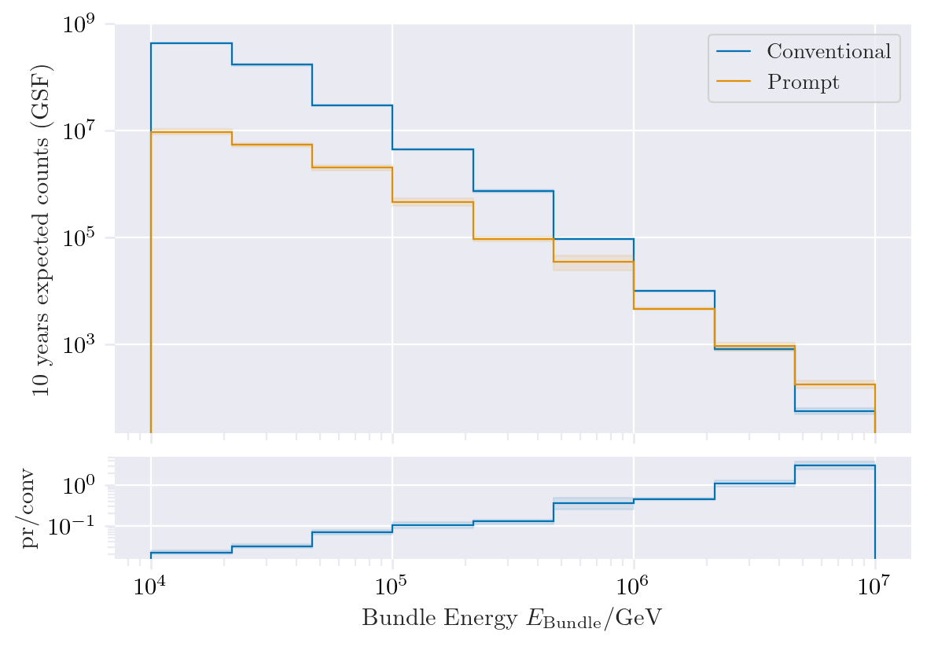
Expected muons for 10 years: leading vs. bundle energy (GSF)
Leading muon energy is more sensitive to detect prompt

Slide 9
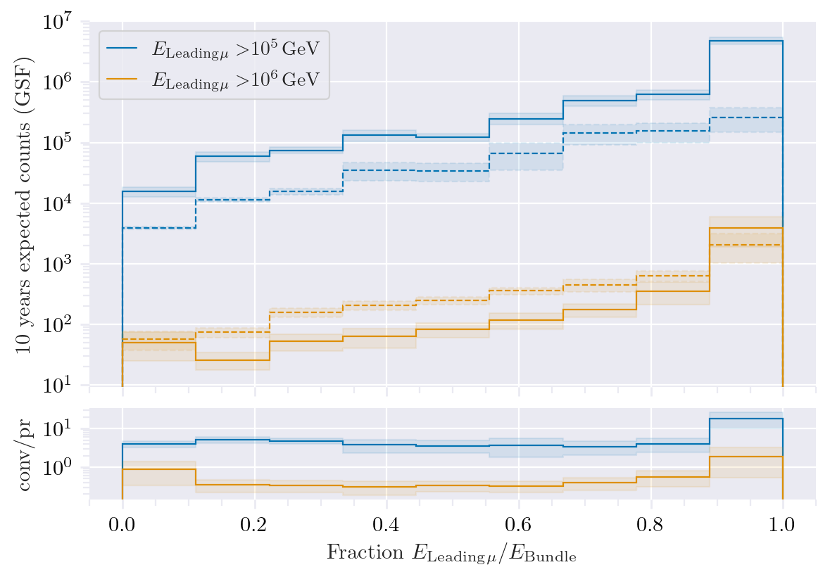
Leading muon energy fraction
Prompt dominates for energies > 1 PeV
Leading energy sweet spot: 0.1 – 0.9
Solid: conventional
Dashed: prompt

Slide 10
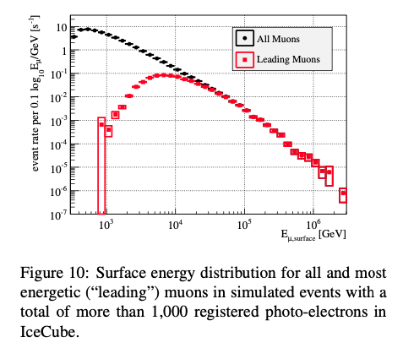
Leading muon contribution
Patrick Berghaus
Muons with energies between 100 TeV and 50 PeV dominate the bundle by more than 90%
In average conventional muons are more dominant than prompt
But: at high energies, there are more prompt than conventional events
High leading energy fraction does not lead to more sensitivity to detect prompt

Slide 11
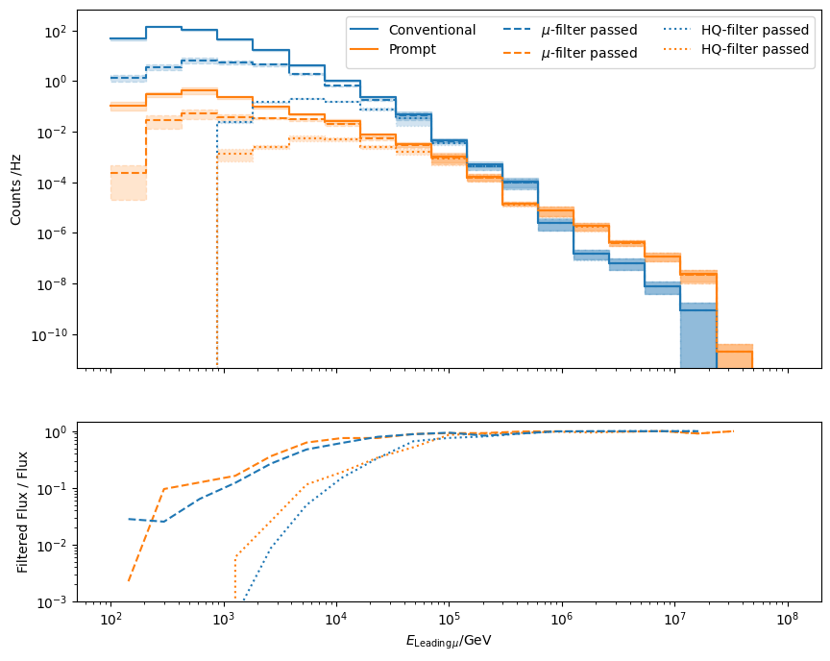
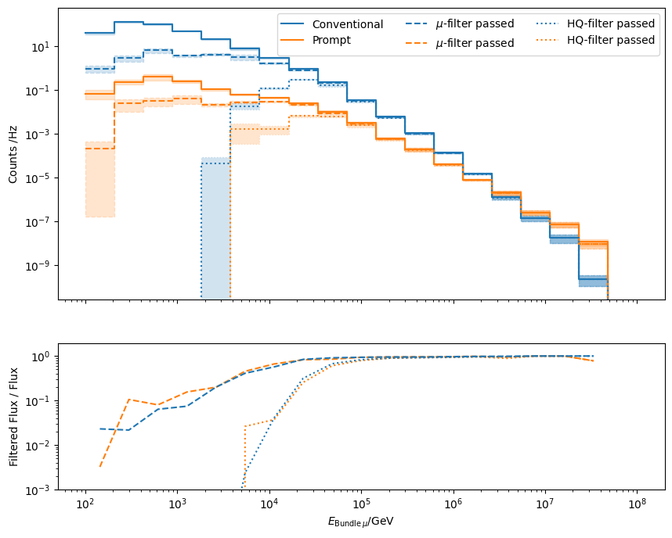
L2 Filters
Fraction events rejected | All energies | Leading energy > 10 TeV | Leading energy > 100 TeV
MuonFilter | 0.93 | 0.28 | 0.06
HQFilter | 0.99 | 0.74 | 0.18
Choose muon filter to remove large amount of statistics at low energies

Slide 12
Data-MC agreements
Two bachelor students worked on reconstructions using the dnn_reco framework (thesis available in english):
Leander Flottau
Benjamin Brandt
Reconstructions:
Leading energy
Leading fraction
Bundle energy
Multiplicity
Azimuth
Zenith
General:
Trained on uncleaned and 6µs cleaned muon pulses
Processed 1 day of experimental data (July 4th, 2020)
Work in progress

Slide 13
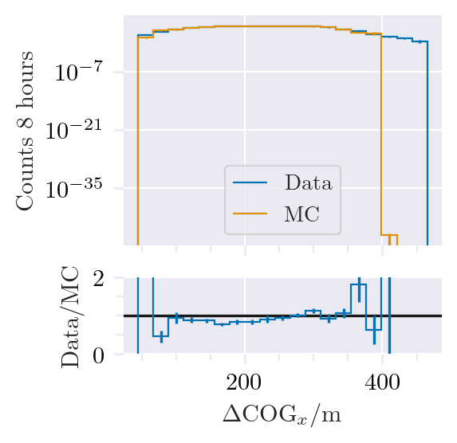
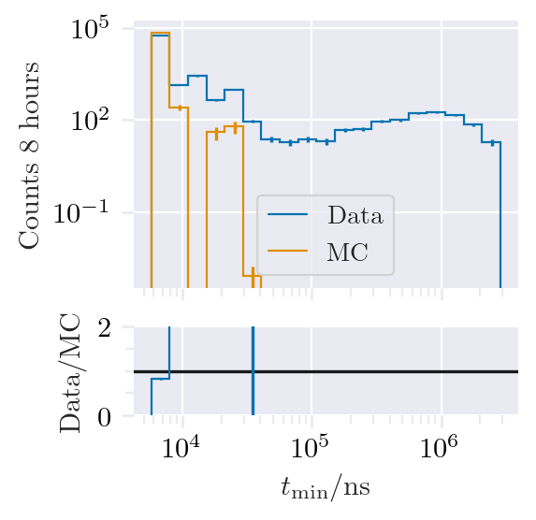
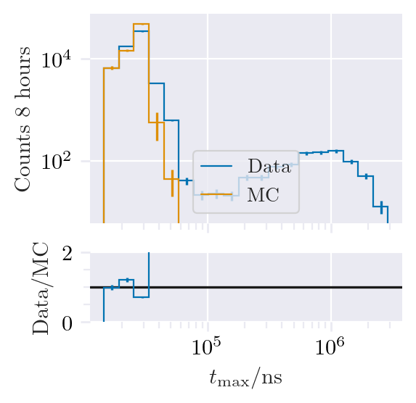
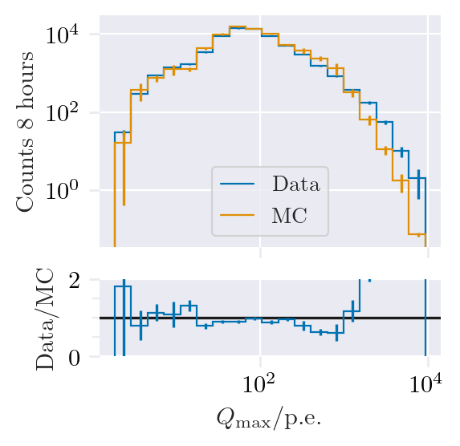
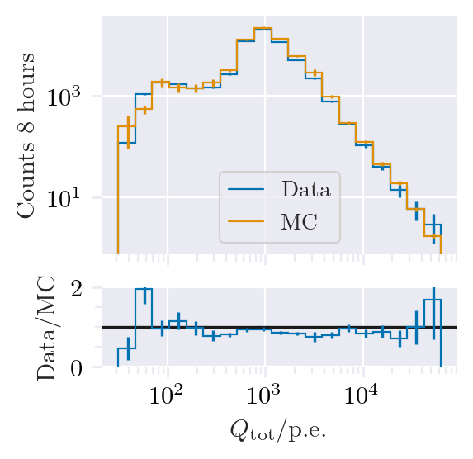
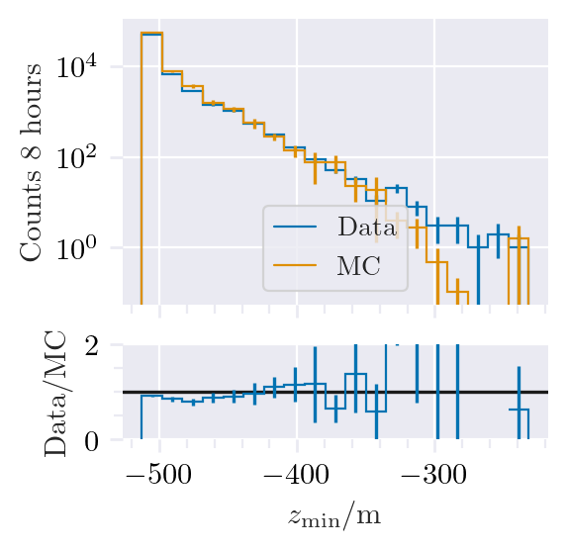
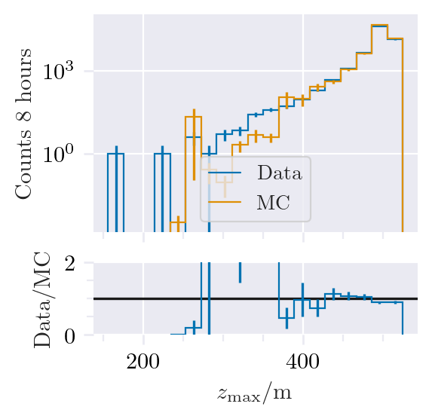
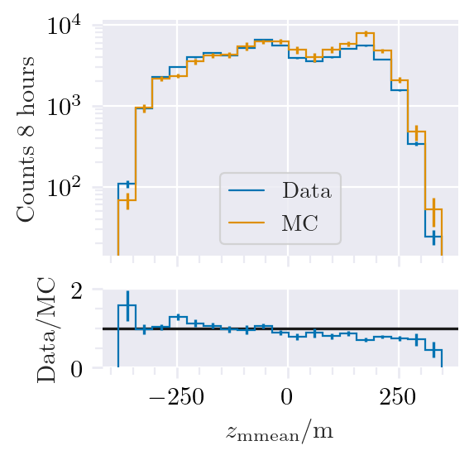
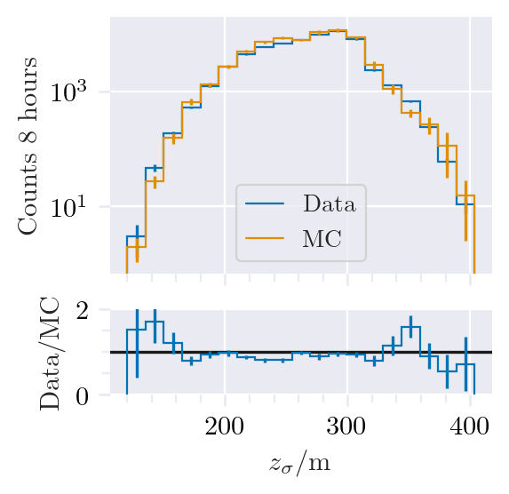
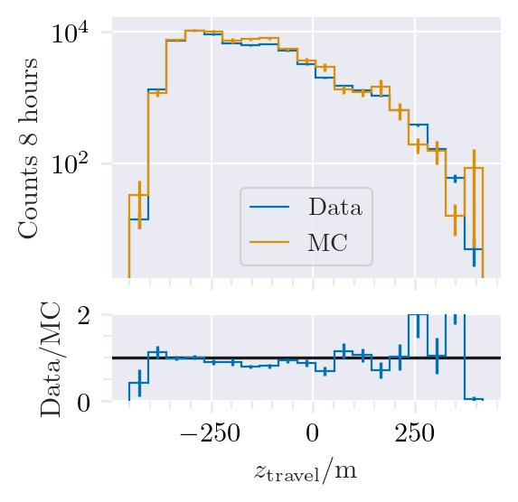
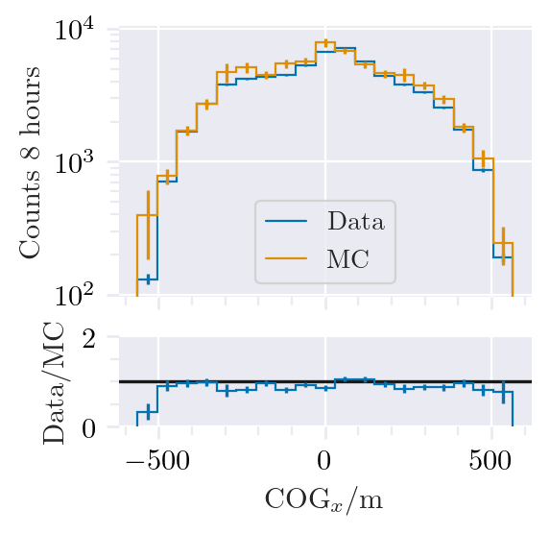
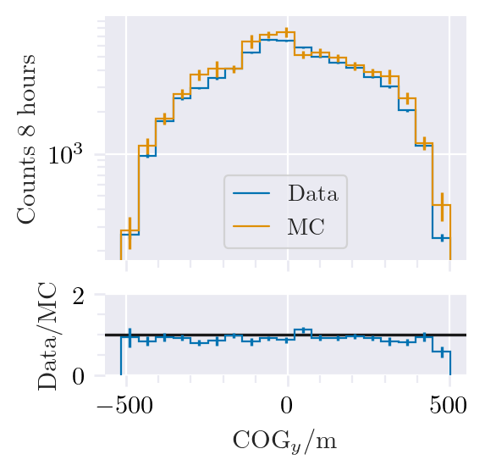
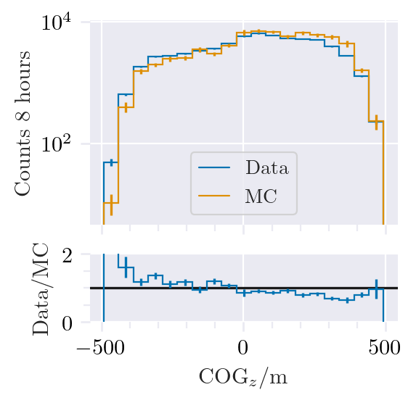
Data-MC: HitStatistics - SplitInIceDSTPulses
L2 Muonfilter
Reconstructed bundle energy > 10 TeV
Good agreement for pulses

Slide 14
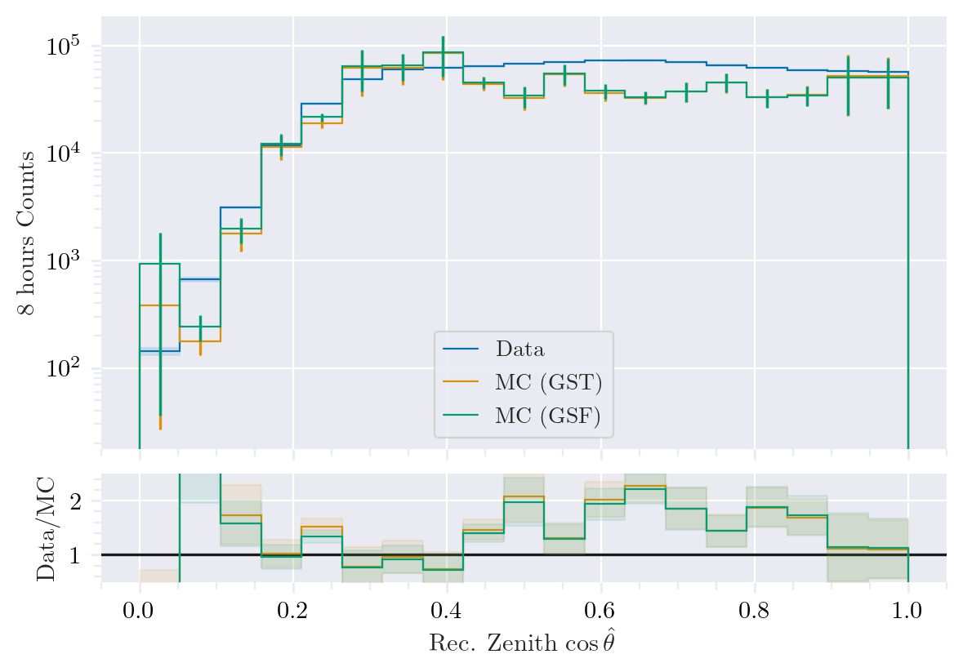
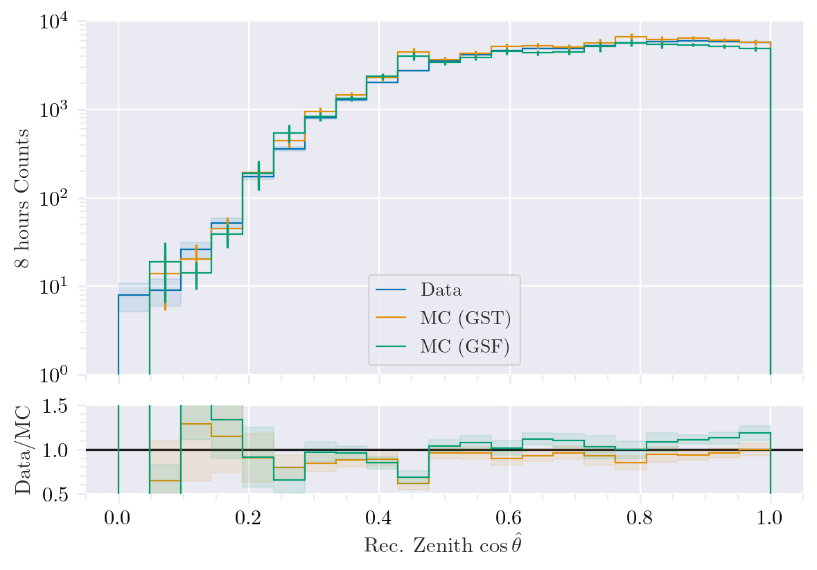
Data-MC: cos(zenith)
Reconstructed bundle energy > 10 TeV
Deviations at low cos(zenith), but very small statistics

Slide 15
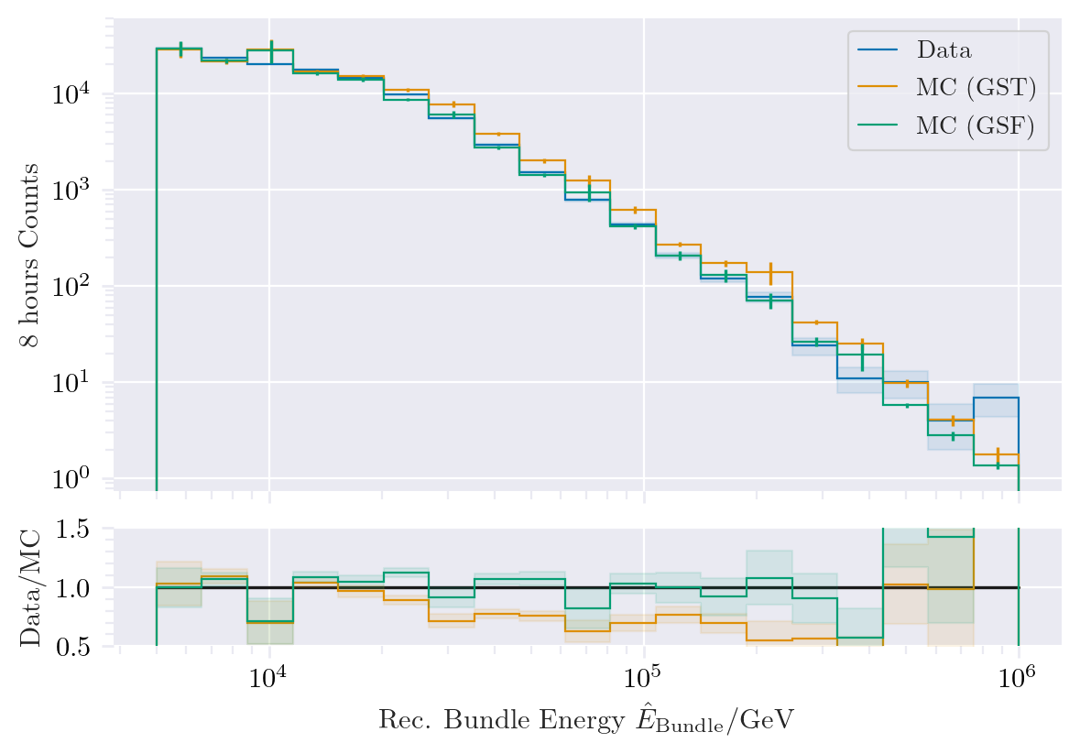
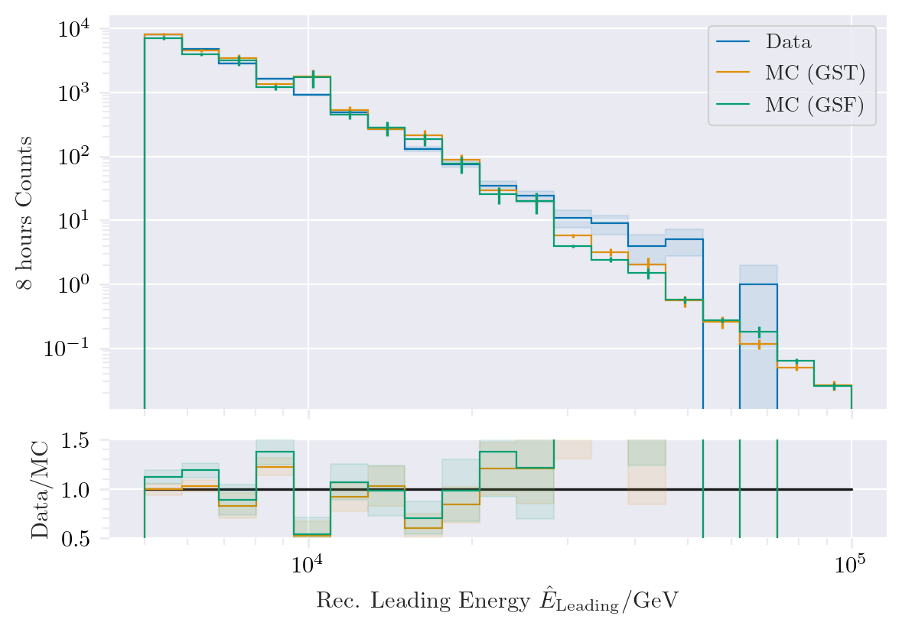
Data-MC: energy spectrum
Prompt?
Bundle energy: good agreement with GSF

Slide 16
Pseudo analysis

Slide 17
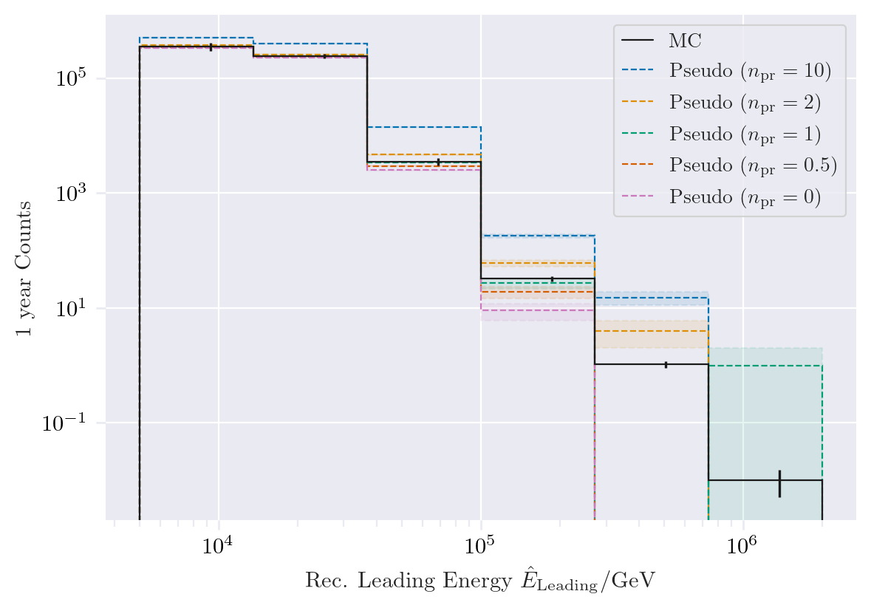
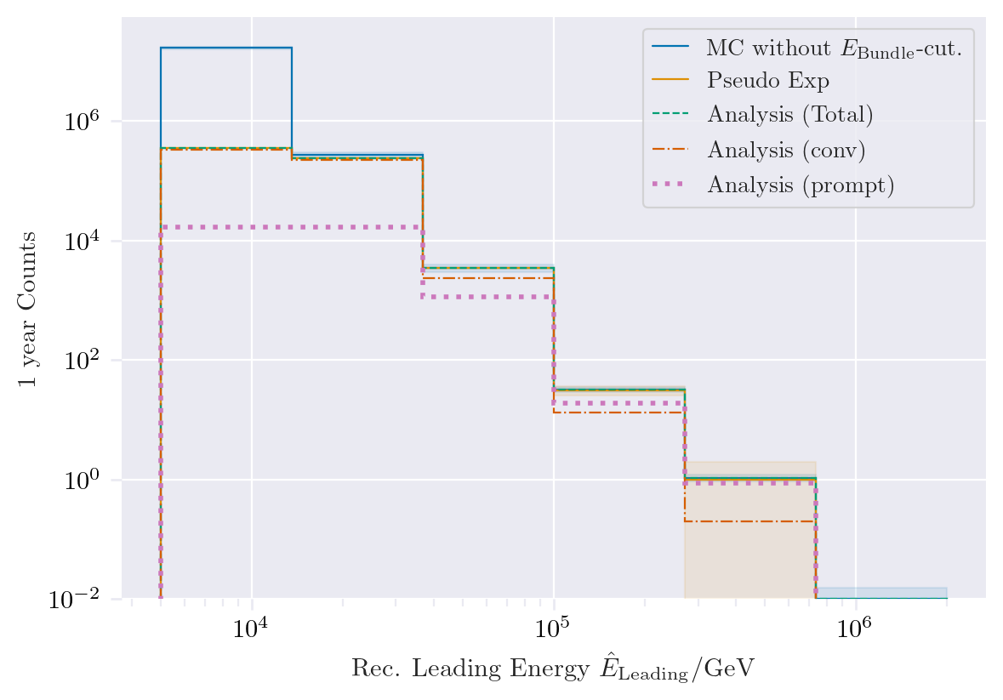
Pseudo data sampling
Cuts:
MuonFilter
Bundle energy > 100 TeV
Tagging allows scaling of prompt by factor n_{pr}

Slide 18
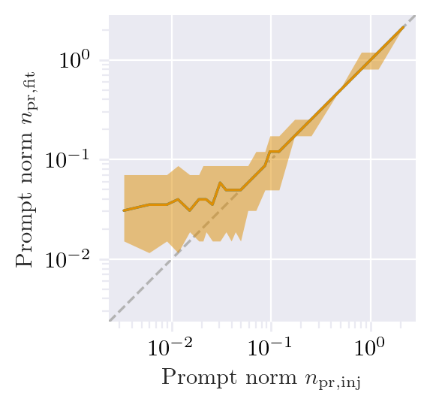
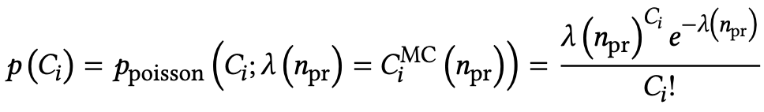
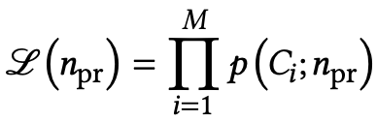
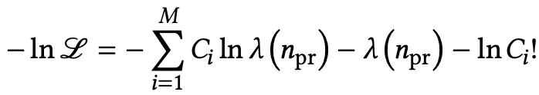
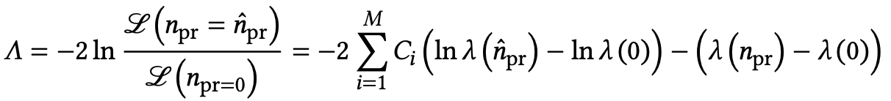
Poisson likelihood fit performed in leading muon energy
Cuts:
MuonFilter
Bundle energy > 100 TeV
Test bias
Prompt scaling/normalization
MC counts per bin i
Conv norm = 1
Experimental counts
Maximize likelihood
With a constant conv norm:
bin counts depend only on prompt norm
= expectation value per bin
Easier:
minimize negative
log-likelihood
Test statistic for Wilk’s theorem
Bias starts below a prompt normalization of 0.1
Null hypothesis: no prompt

Slide 19
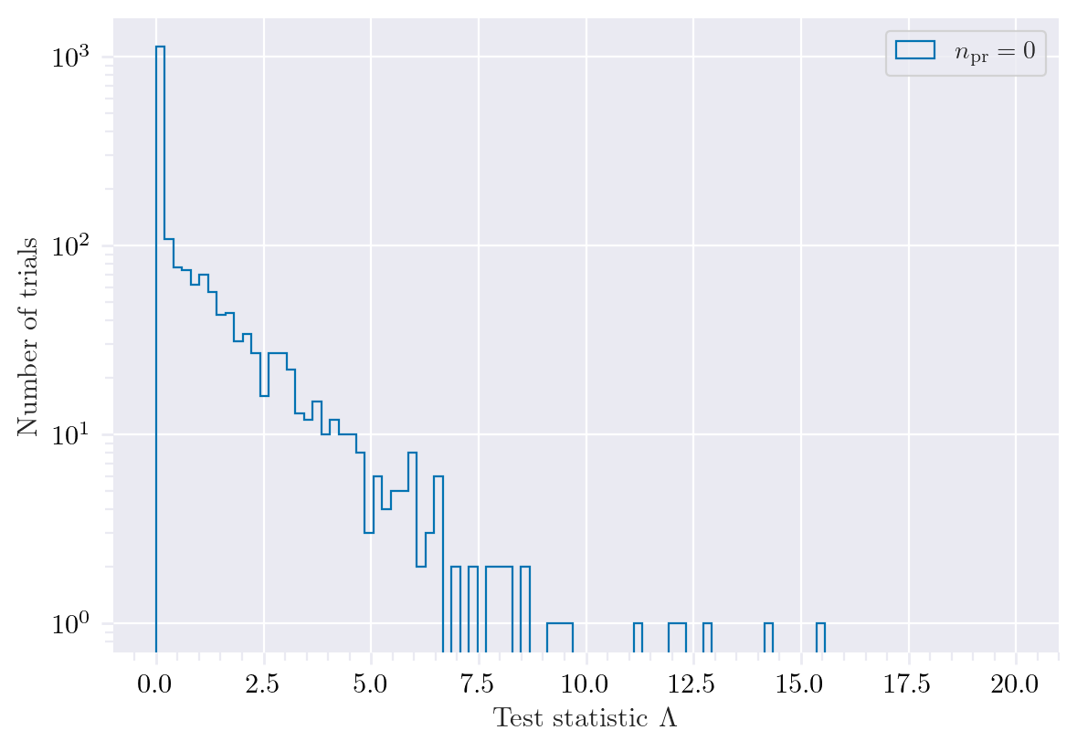
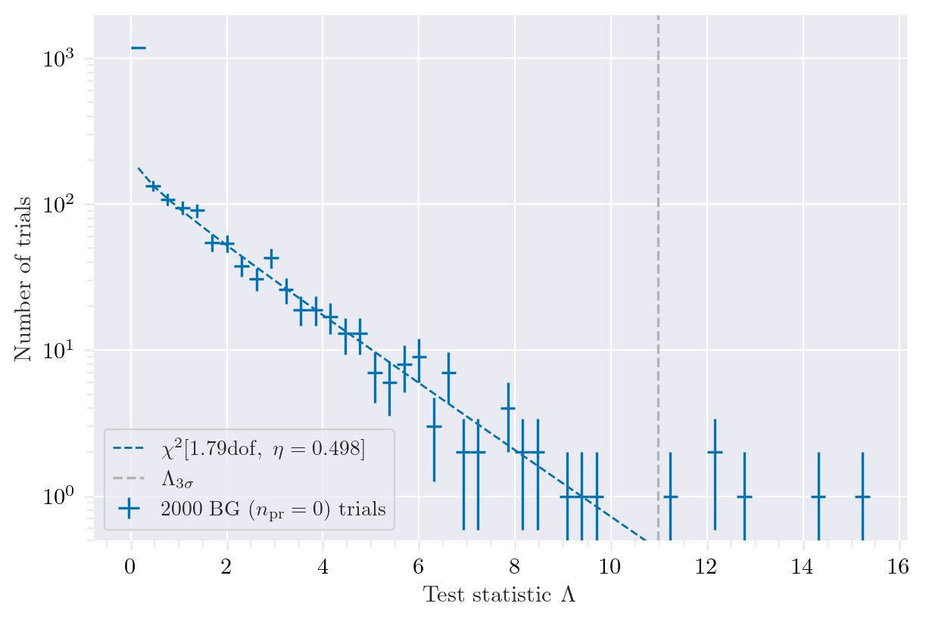
Test background statistics
Cuts:
MuonFilter
Bundle energy > 100 TeV
Background statistic is 𝛘² – distributed
Assume Wilks’ theorem for test statistics

Slide 20
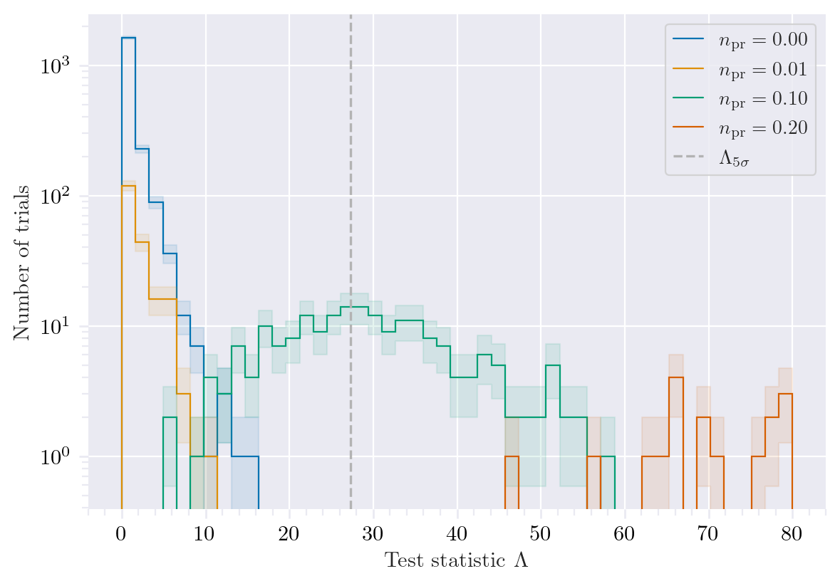
Discovery potential and sensitivity
Cuts:
MuonFilter
Bundle energy > 100 TeV
Expectation for 1 year:
5 sigma discovery potential: 0.102 ± 0.005
Sensitivity: 0.024 ± 0.001
Expectation for 10 years:
5 sigma discovery potential: 0.032 ± 0.001
Sensitivity: 0.007 ± 0.000
Caution:
Limited MC statistics -> events are oversampled in pseudo dataset

Slide 21
Conclusion Outlook
New CORSIKA EHIST simulations
CORSIKA vs. MCEq agreement
DNN angular and energy reconstructions
First data-MC comparisons
Pseudo analysis is set up
Results are promising
Wiki page
Data-MC agreement of dnn input
Optimize DNN reconstructions
Include systematics (snowstorm)
Scattering
Absorption
Anisotropy
Hole ice 1
Hole ice 2
Dom efficiency
Conventional normalization
We do not include systematics of the primary fluxes, instead we perform the analysis several times for different flux models
Entire analysis is based on CORSIKA 7 and SIBYLL 2.3d, perform “minor” simulation with another hadronic model?
Thank you for your attention ☺

Slide 22
Backup

Slide 23

Definition of the muon flux
$φ_{tot}=φ_{conventional}+φ_{prompt}$
$π, Κ$ ∝ E^{-3.7}
“not” $π, Κ \text{∝ }\text{E}\text{−}\text{2}\text{.7}$

Slide 24
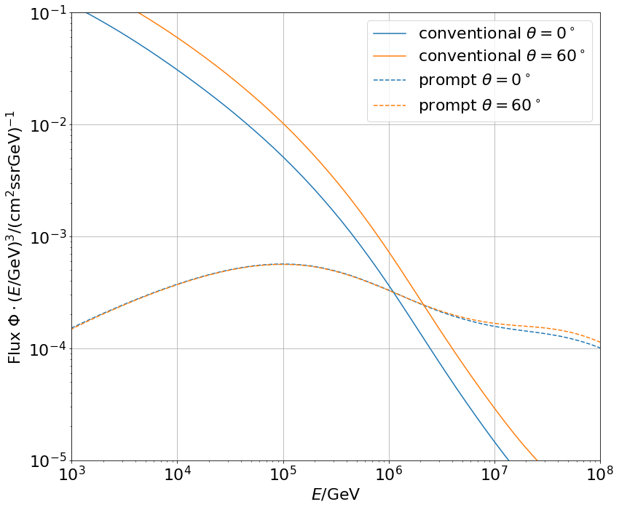
Muon flux
0°: perpendicular to Earth’s surface
$$φ_{tot}=φ_{conv}+φ_{prompt}$$
Prompt dominates at energies larger than PeV
Conventional particle flux depends on zenith angle
conventional
prompt
We can measure prompt muon energies from ~1 PeV to ~100 PeV

Slide 25
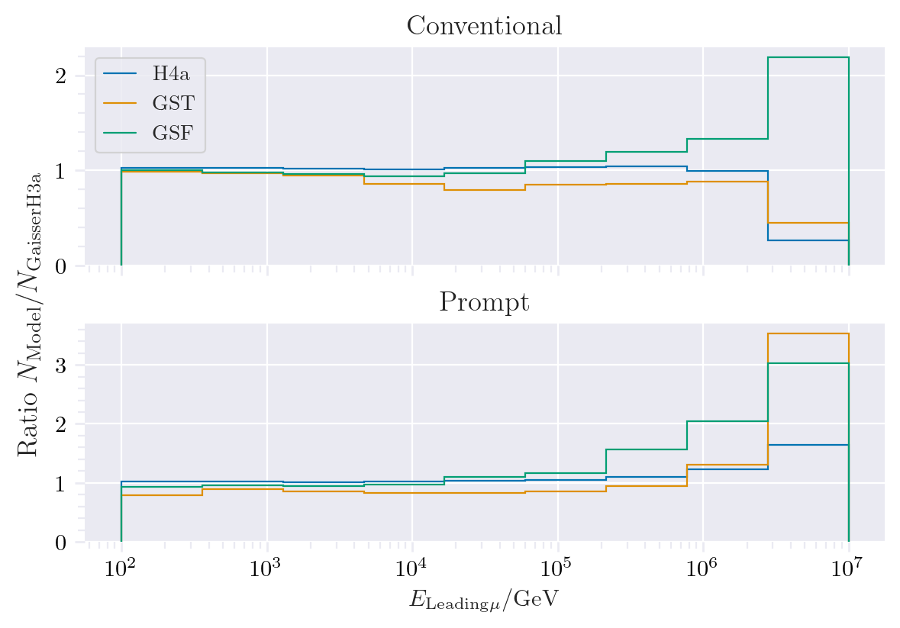
Muon production – different weightings
GST predicts most prompt
MCLabelsLeadingMuons_entry_energy

Slide 26
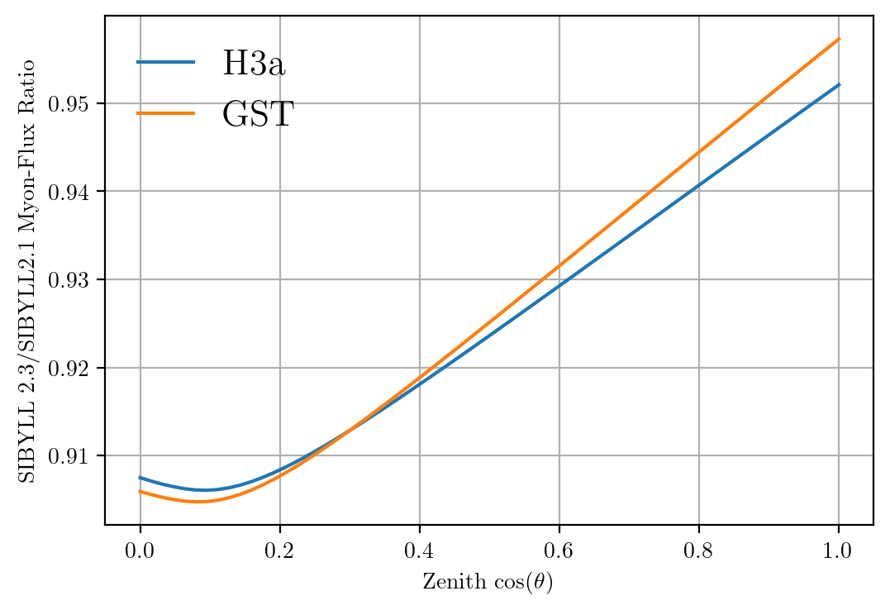
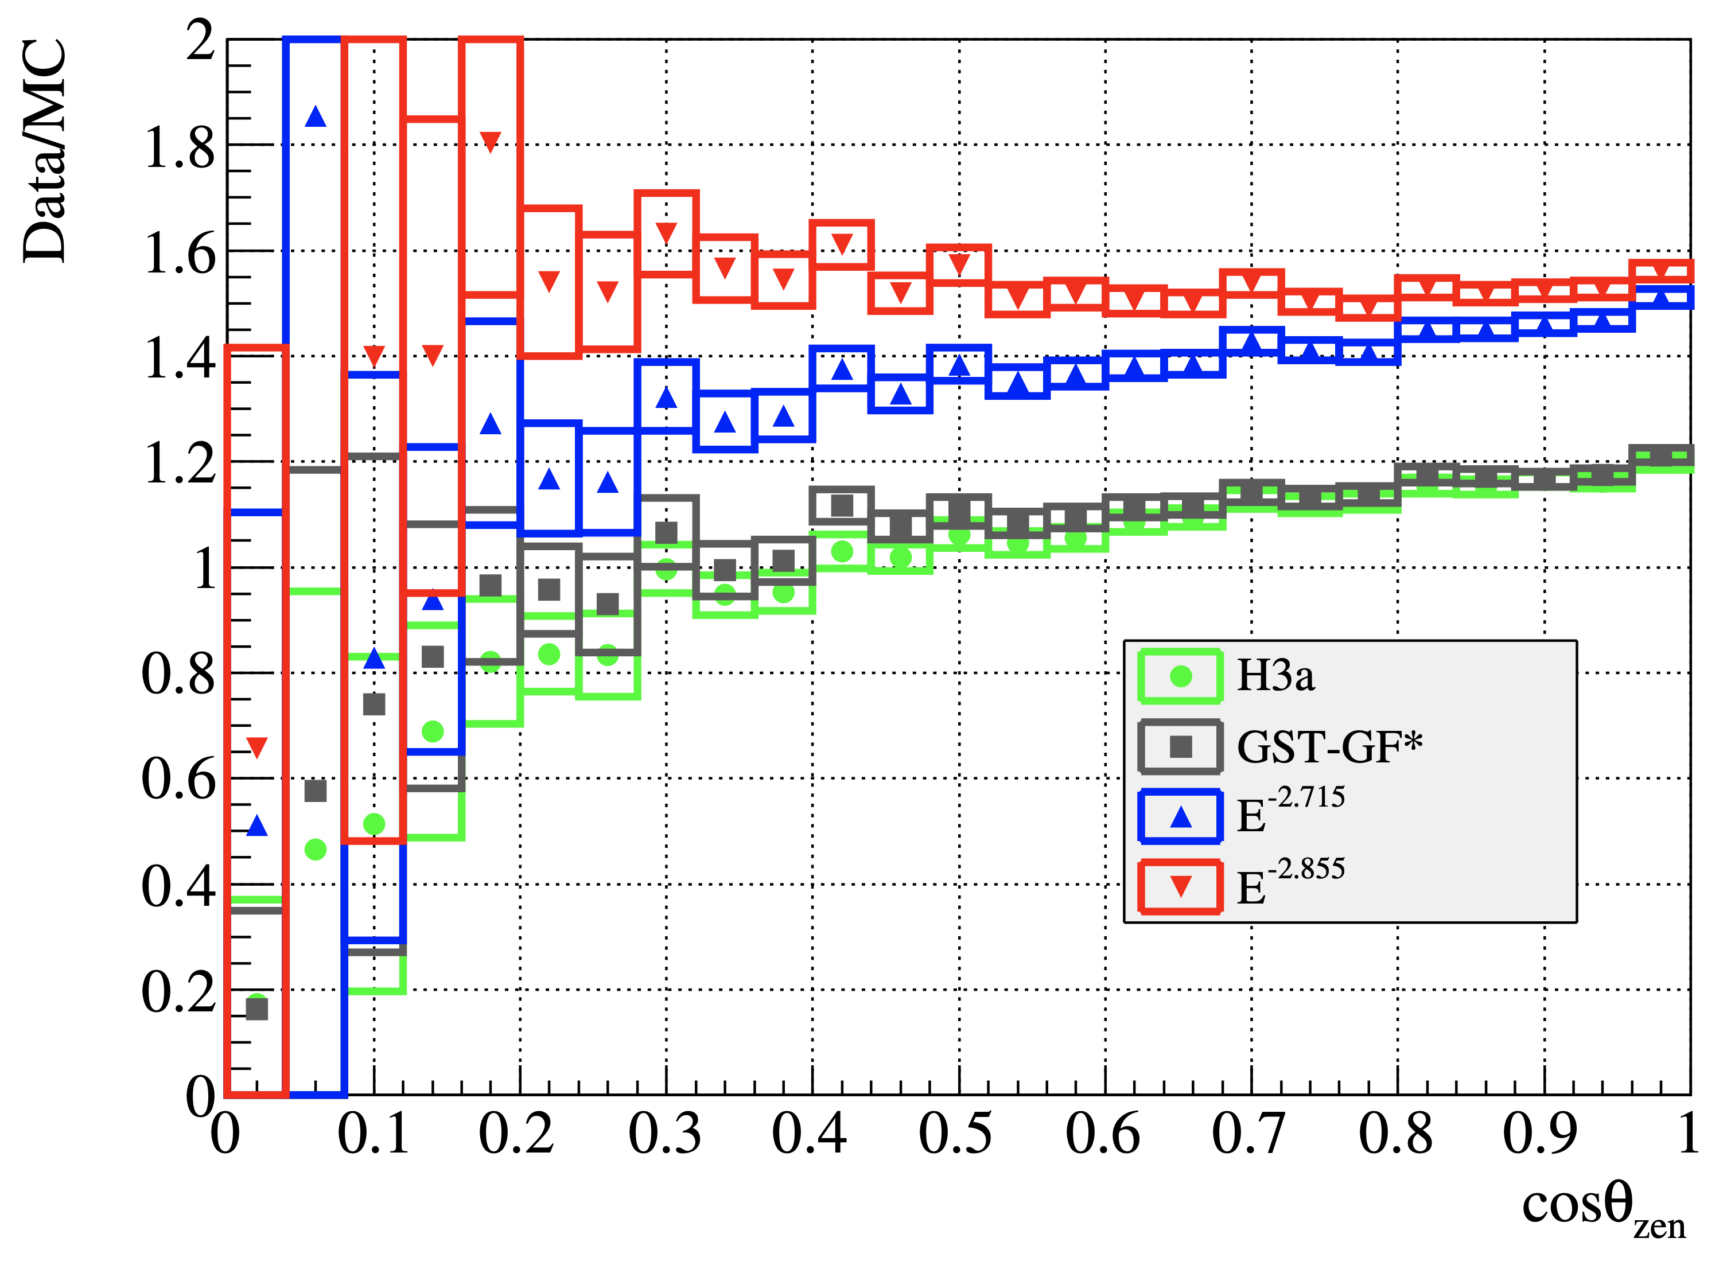
Solution to zenith problem?
No complete solution, but a step in the right direction

Slide 27
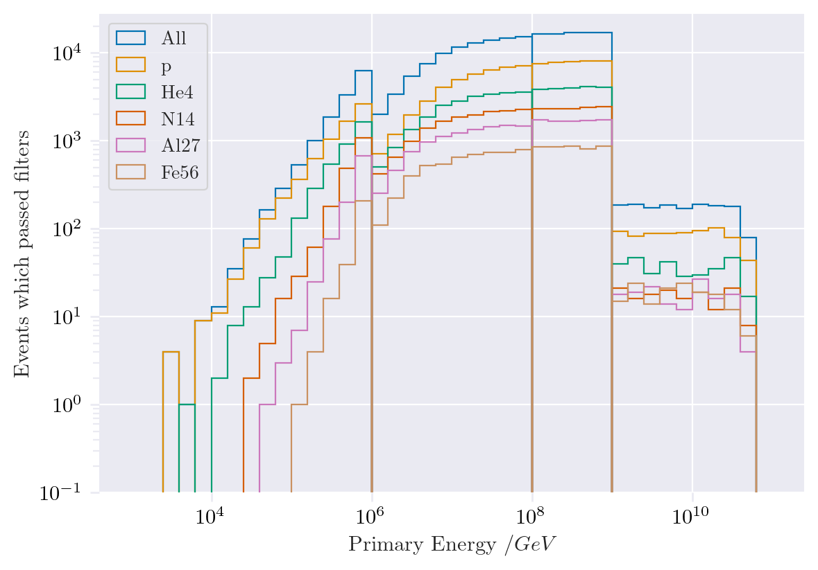
Simulated events
Passed muon filter

Slide 28
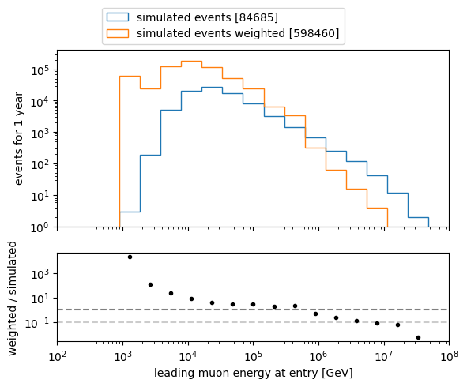
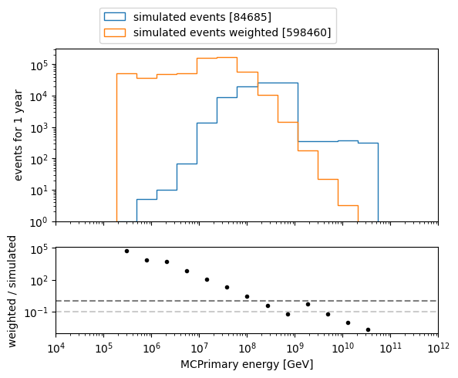
Which energies to we need to simulate?
L2 MuonFilter
Bundle energy > 100 TeV

Slide 29
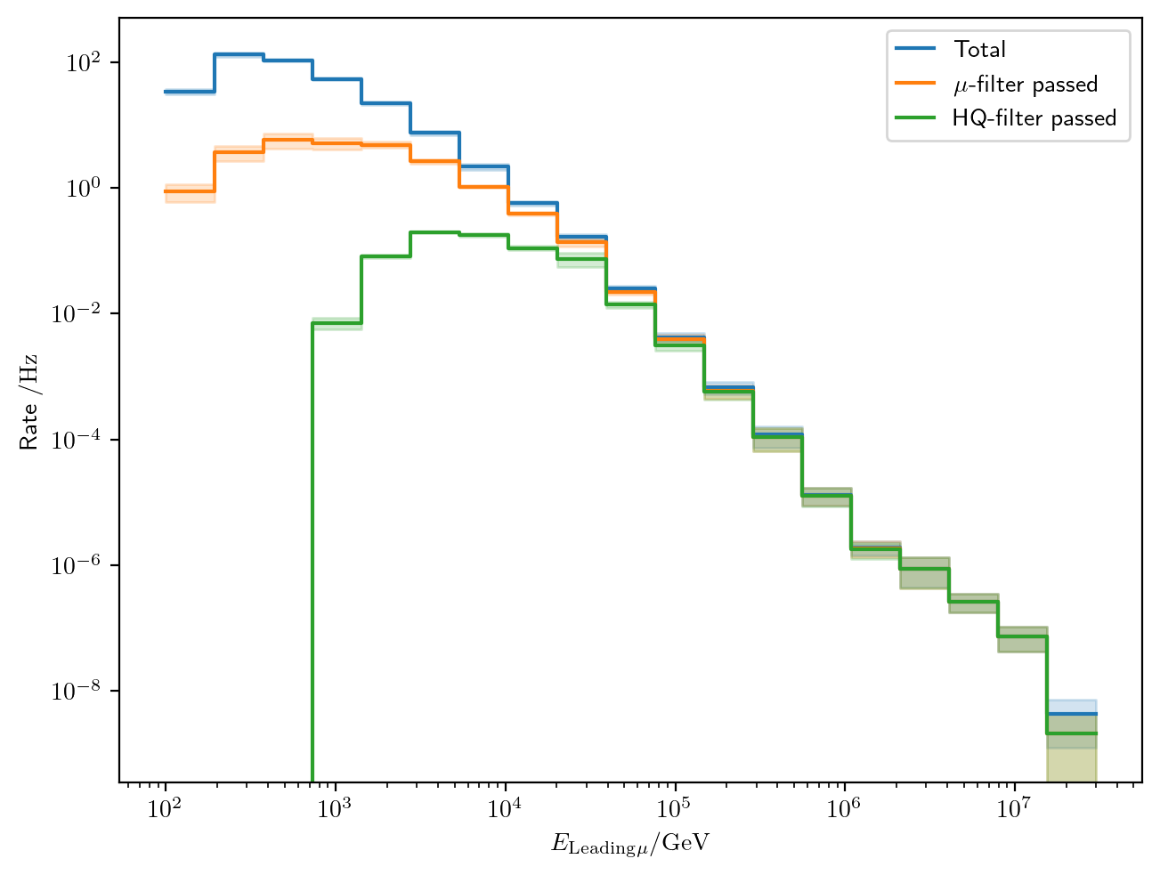
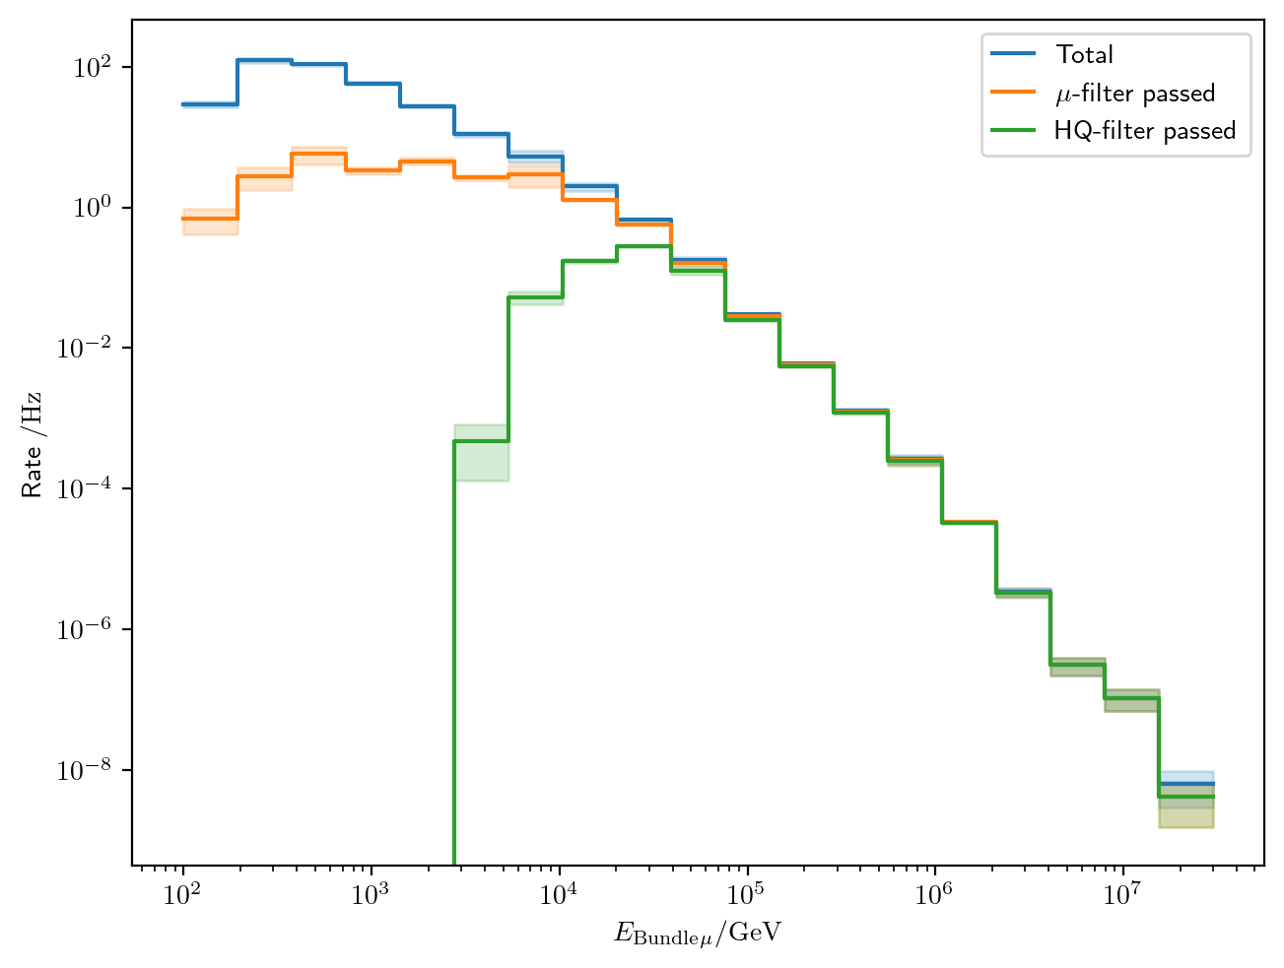
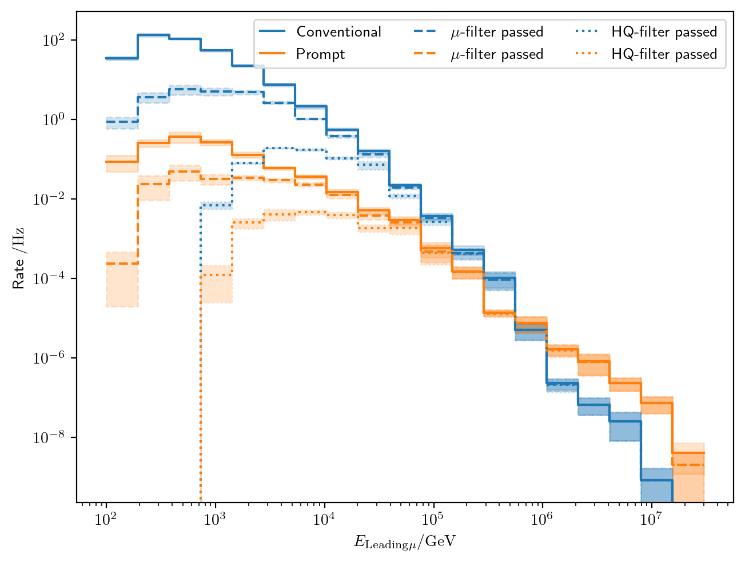

Filters
Choose muon filter,
larger statistics at 10 TeV

Slide 30

Filters – passed events per leading energy

Slide 31













Data-MC: HitStatistics - SplitInIceDSTPulses
L2 MuonFilter
No further exclusions

Slide 32
Evaluation of models used in pseudo analysis
Note: the DNN reconstruction models are still investigated! The models used here are in an early stage. So far, the two bachelor students have trained models with better performance.
Updates on the models and reconstructions are provided in the near future

Slide 33

Zenith reconstructions

Slide 34

Azimuth reconstructions

Slide 35

Angular resolution

Slide 36

Bundle energy reconstruction

Slide 37

Leading energy reconstruction

